Slide 1

GROUP 11 MASTER YOUR MEMORY
AKASH PIPALIA (A20380807)
BHARATIBEN KYADA (A203536363)
ROHAN BORDE (A20375497)
SUDIPTA SWARNAKAR (A20377210)

Slide 2
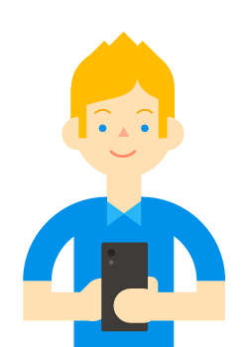
FEATURES & USER EXPERIENCE
User Account
Categories
Difficulty Levels
Multiple Languages
Background Sound
Top Score
Personal Score
Automatic Adjustment of Grid

Slide 3
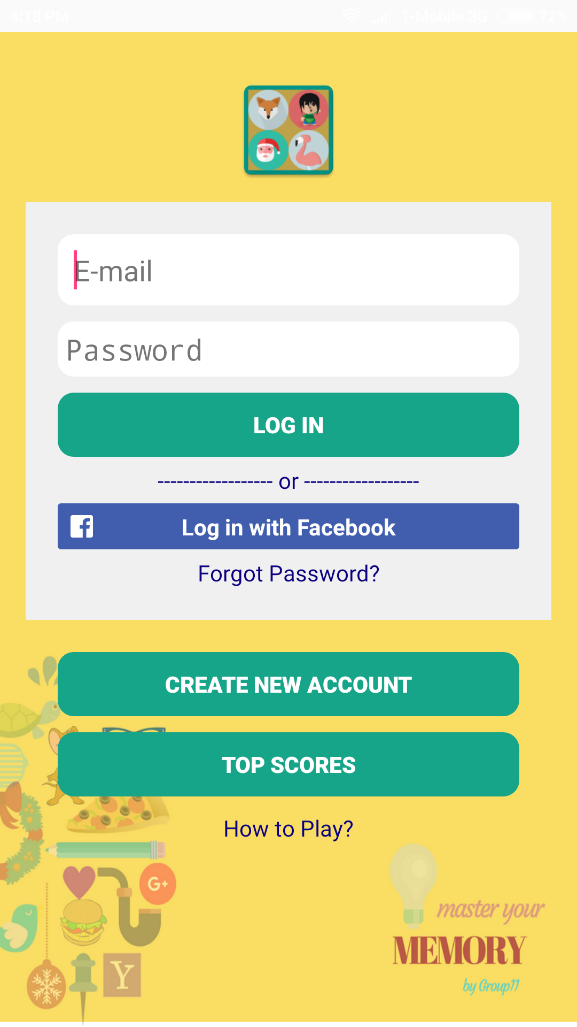
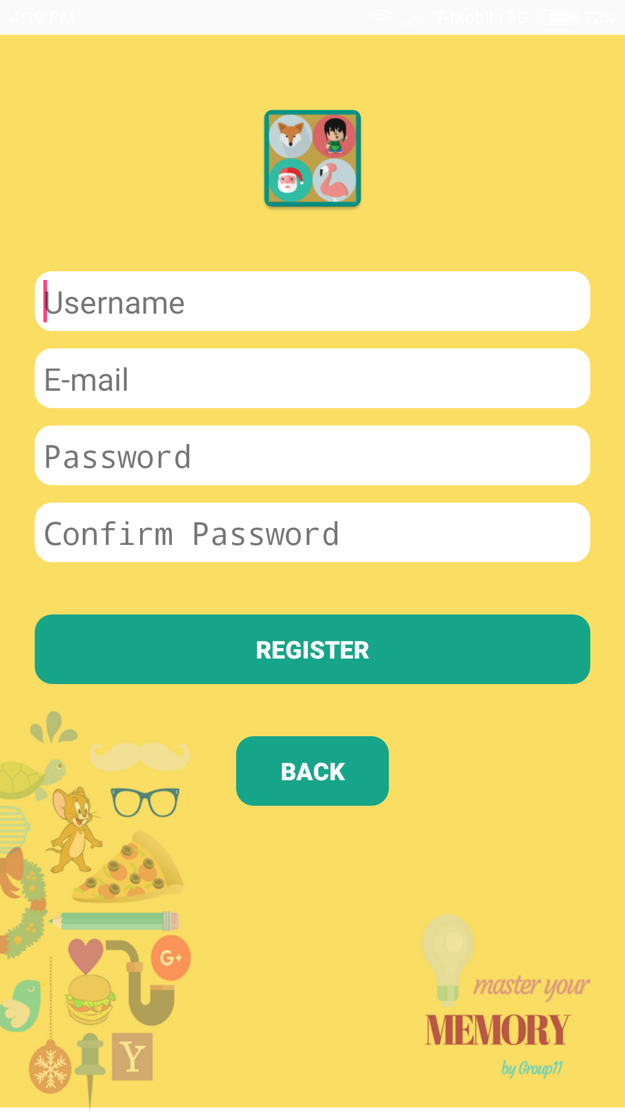
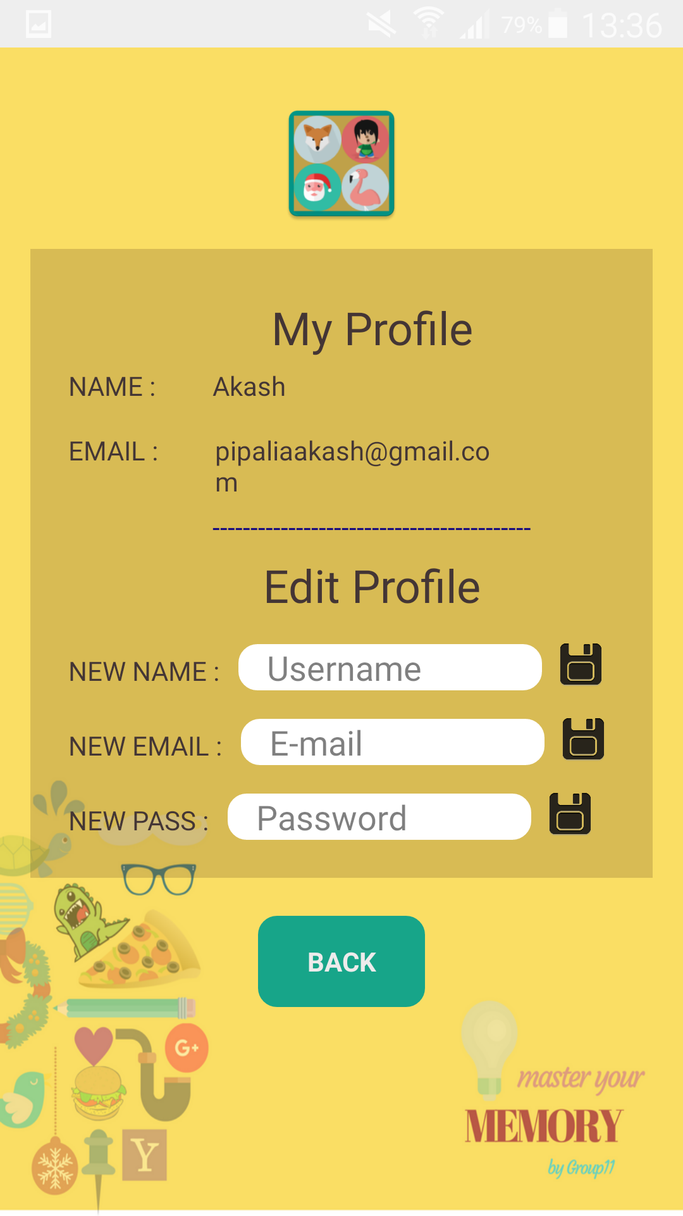
Login, Register and Edit User

Slide 4
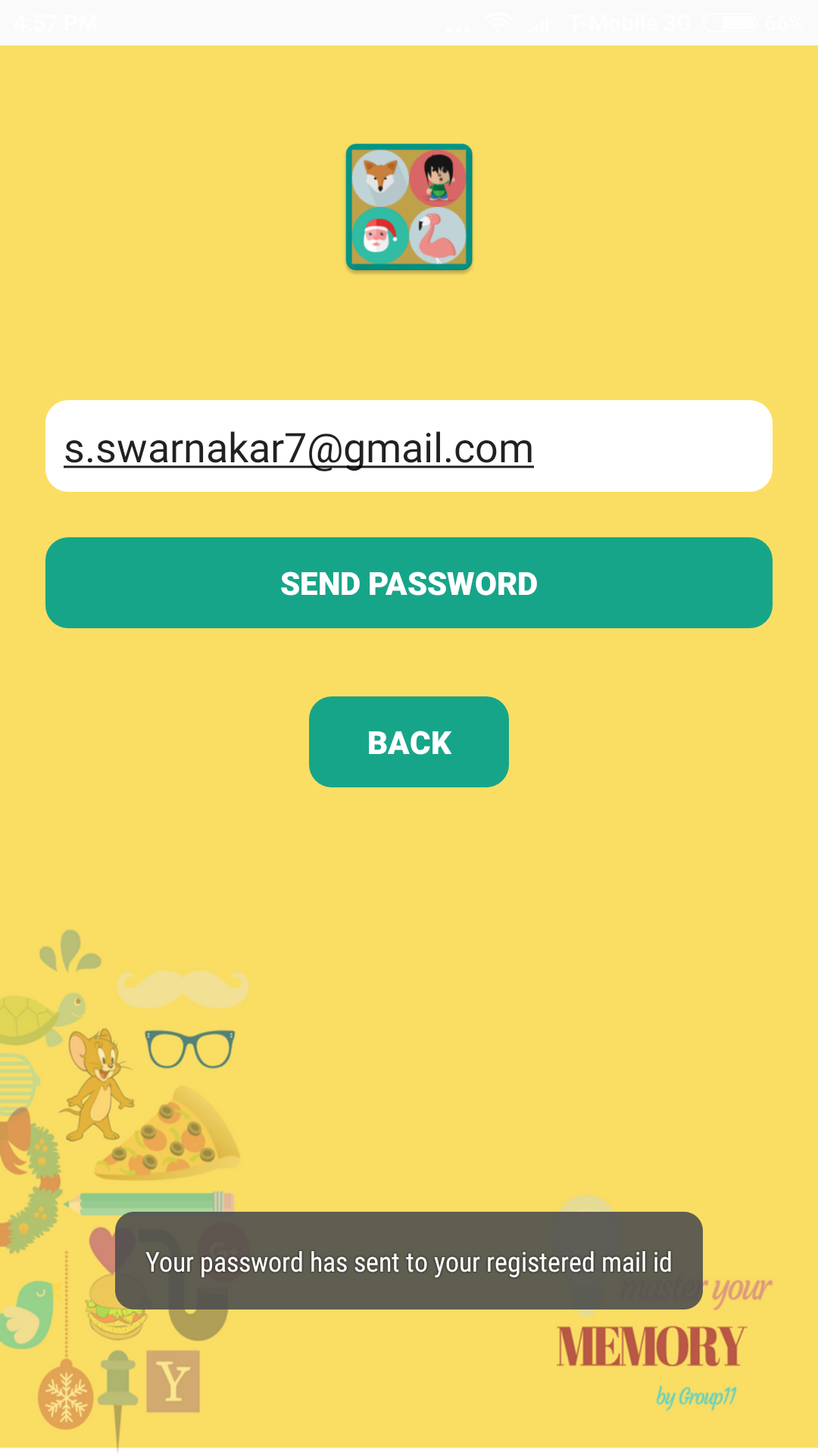
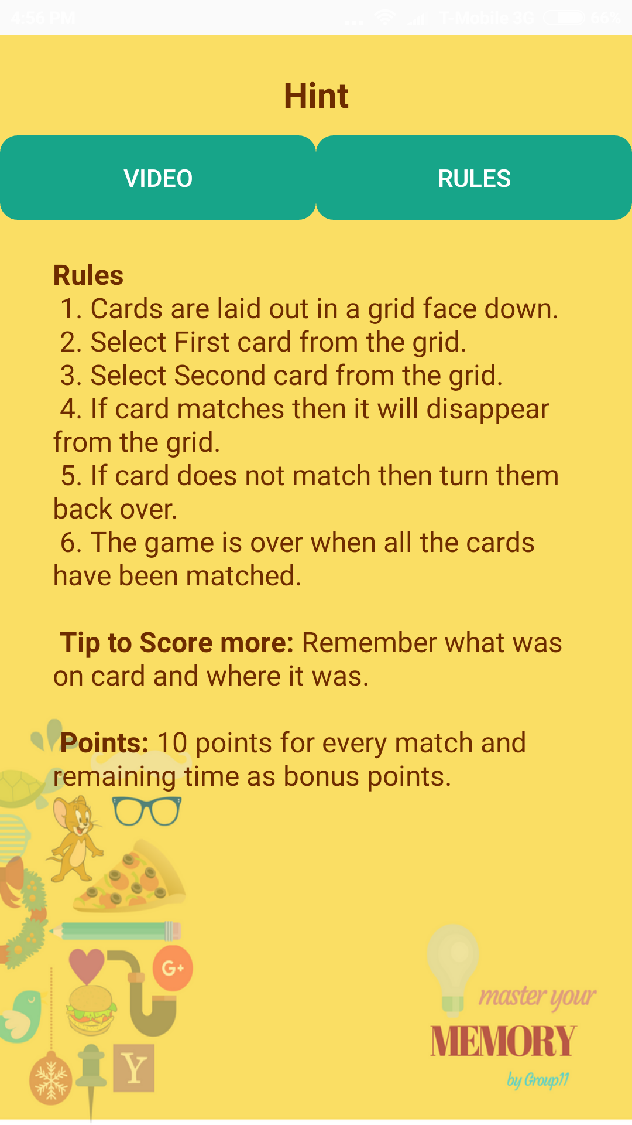
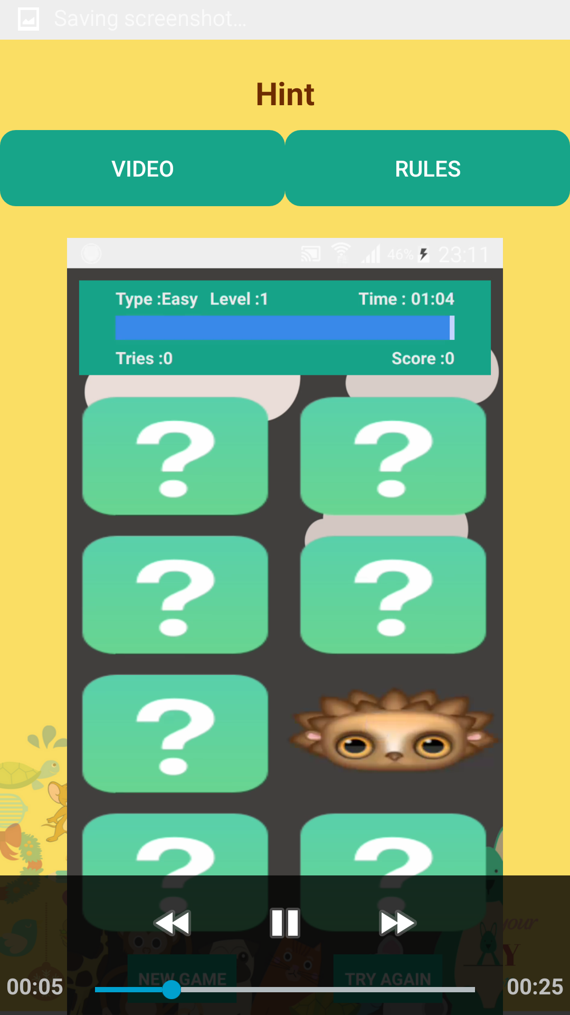
Forget Password and Help

Slide 5
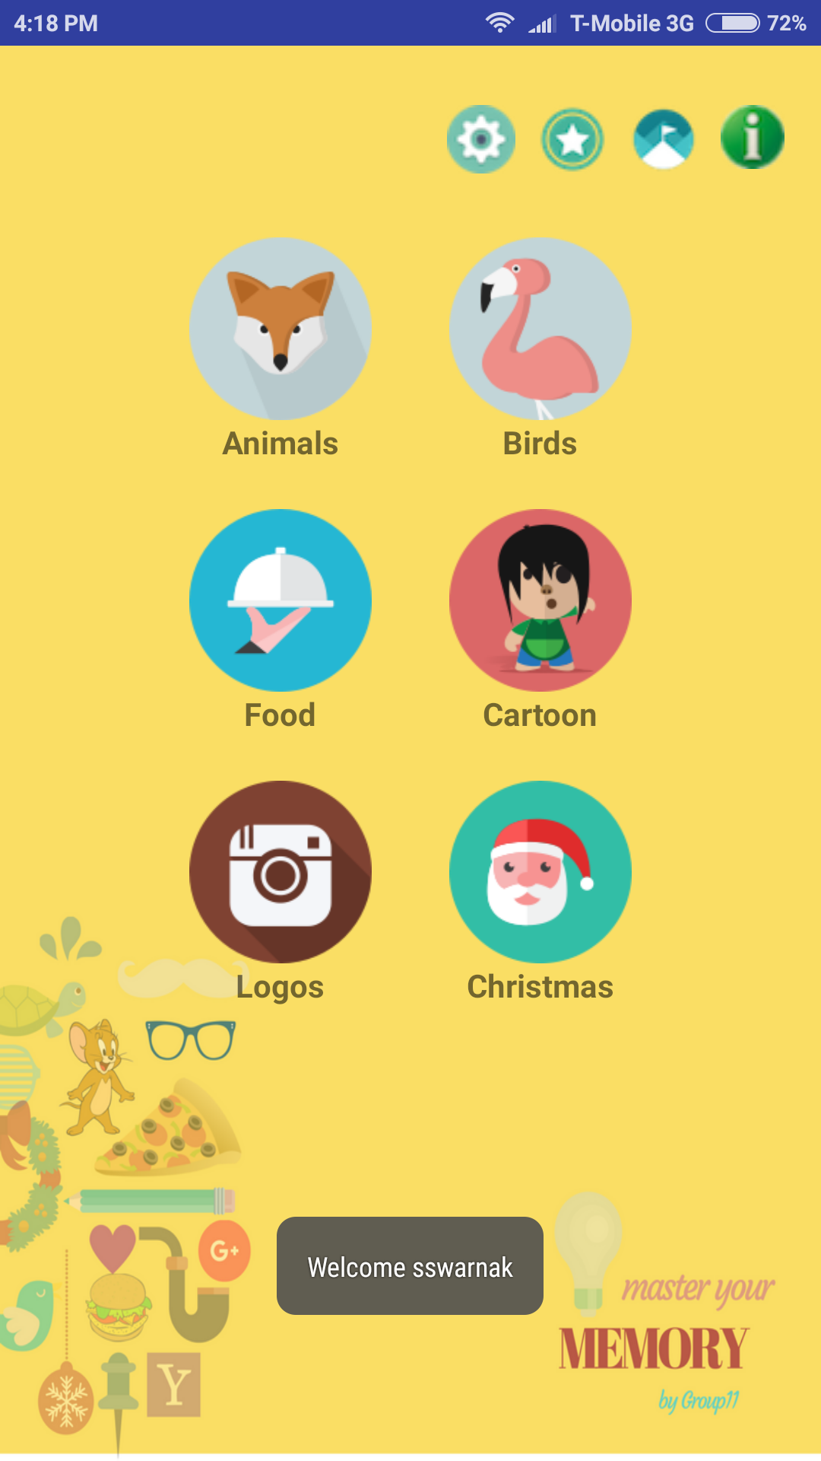
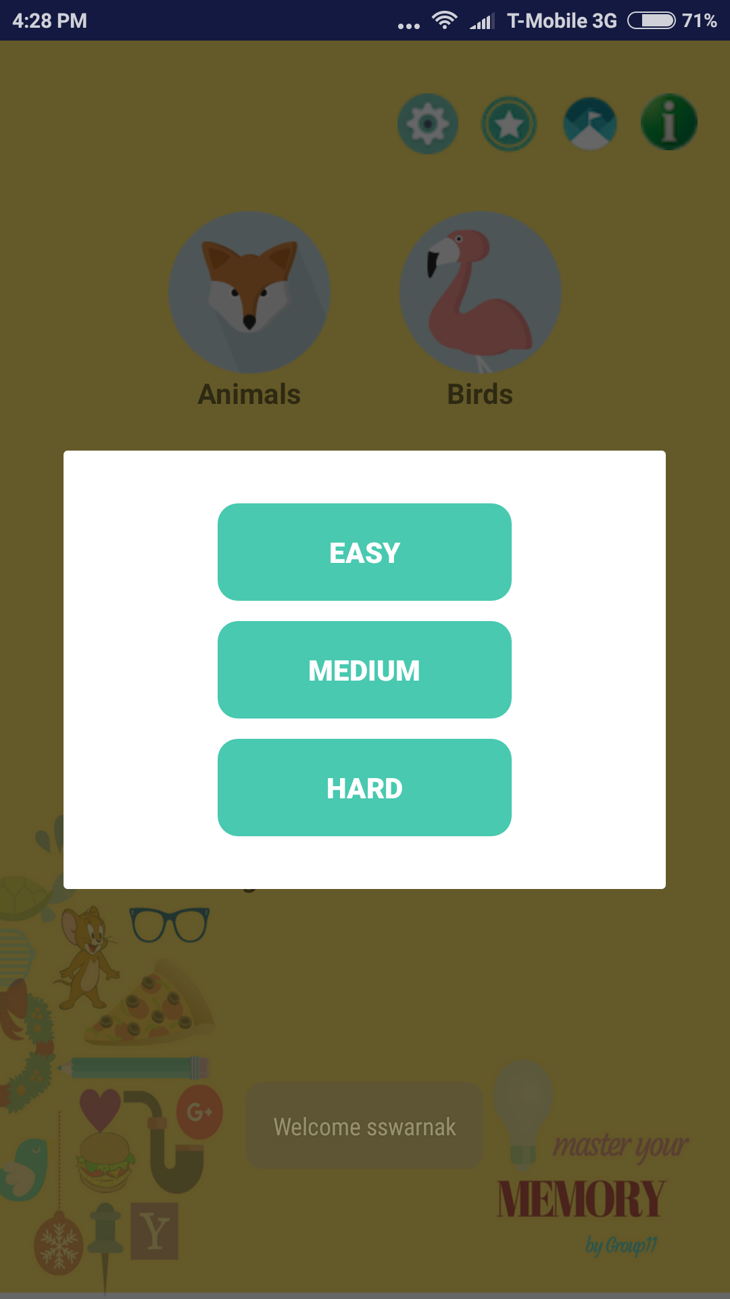
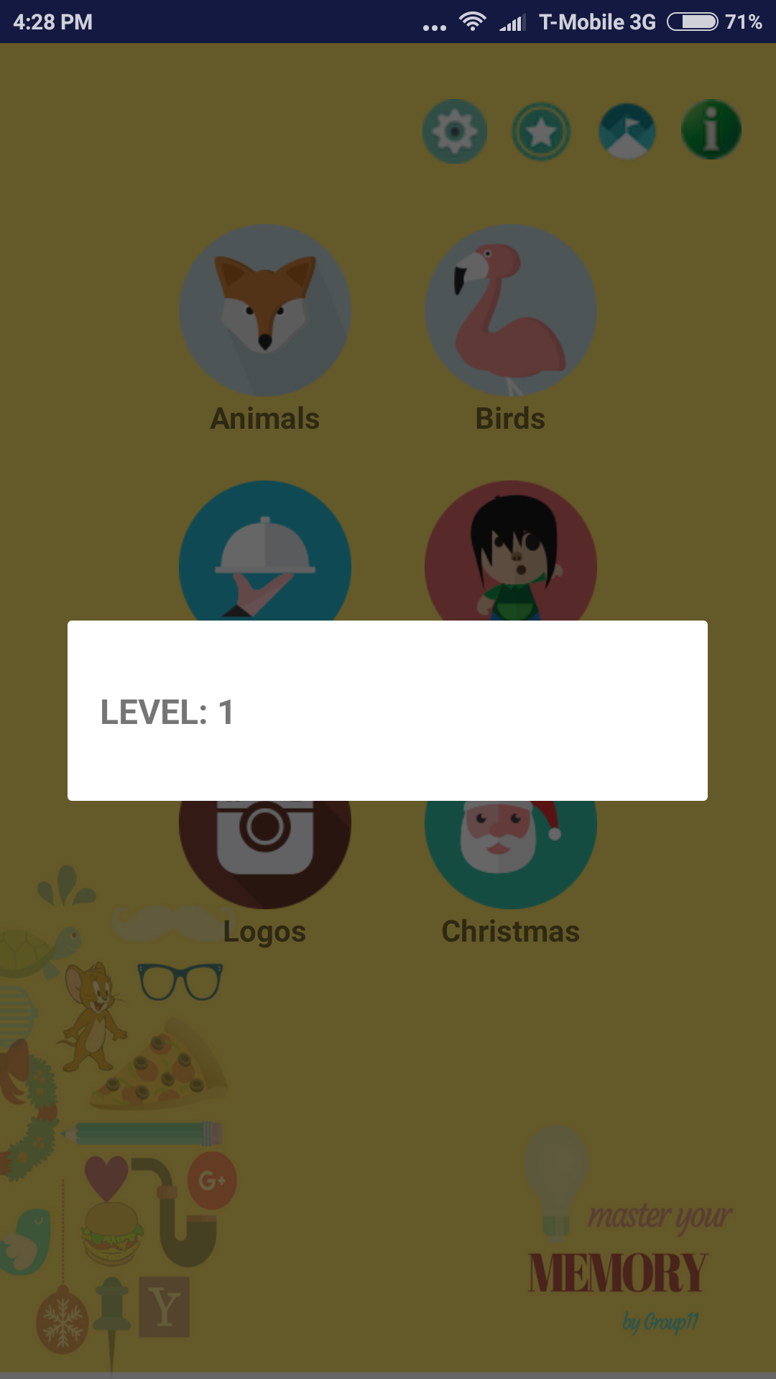
Select Categories & Difficulty Levels

Slide 6
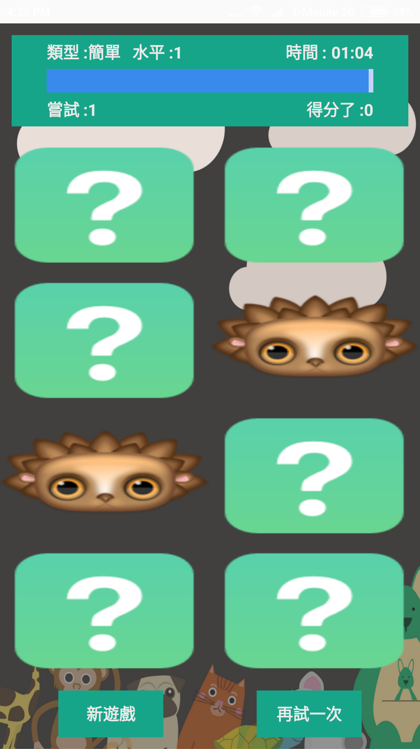
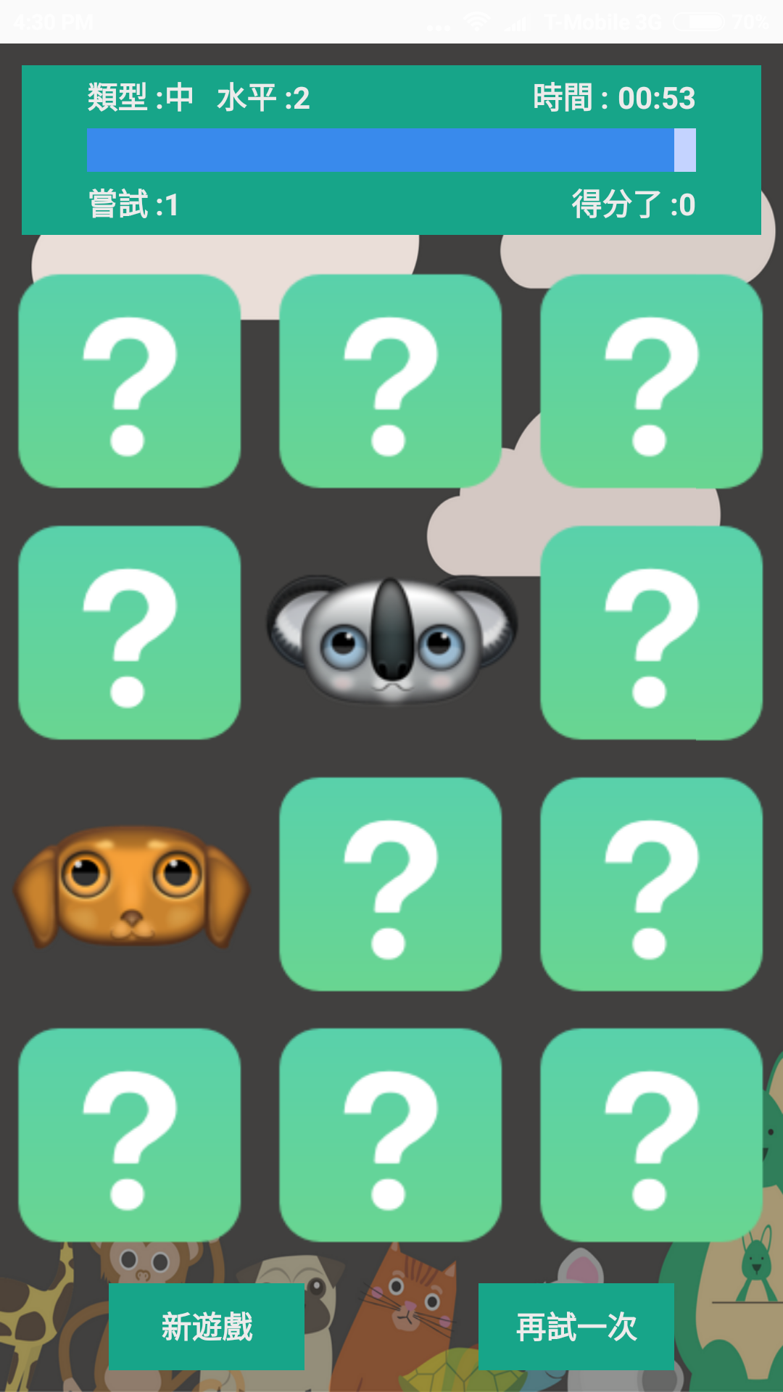
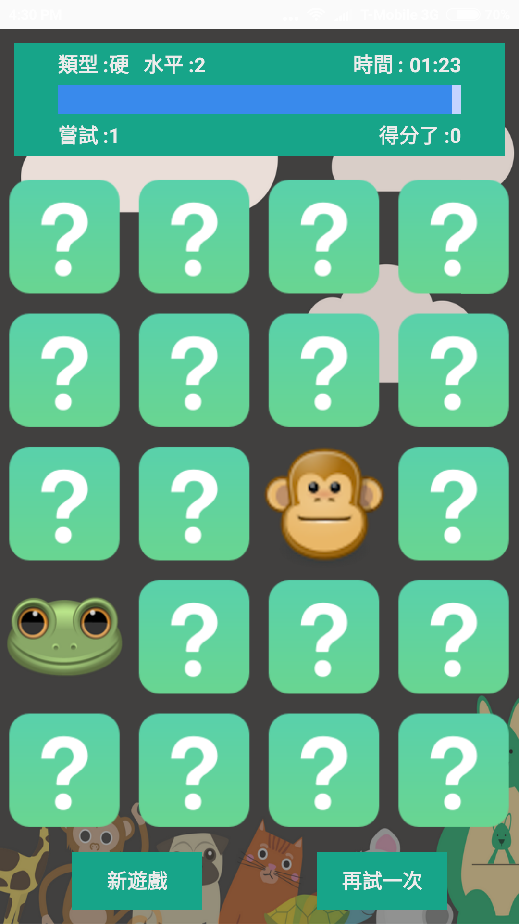
Automatic Adjustment of Grids

Slide 7
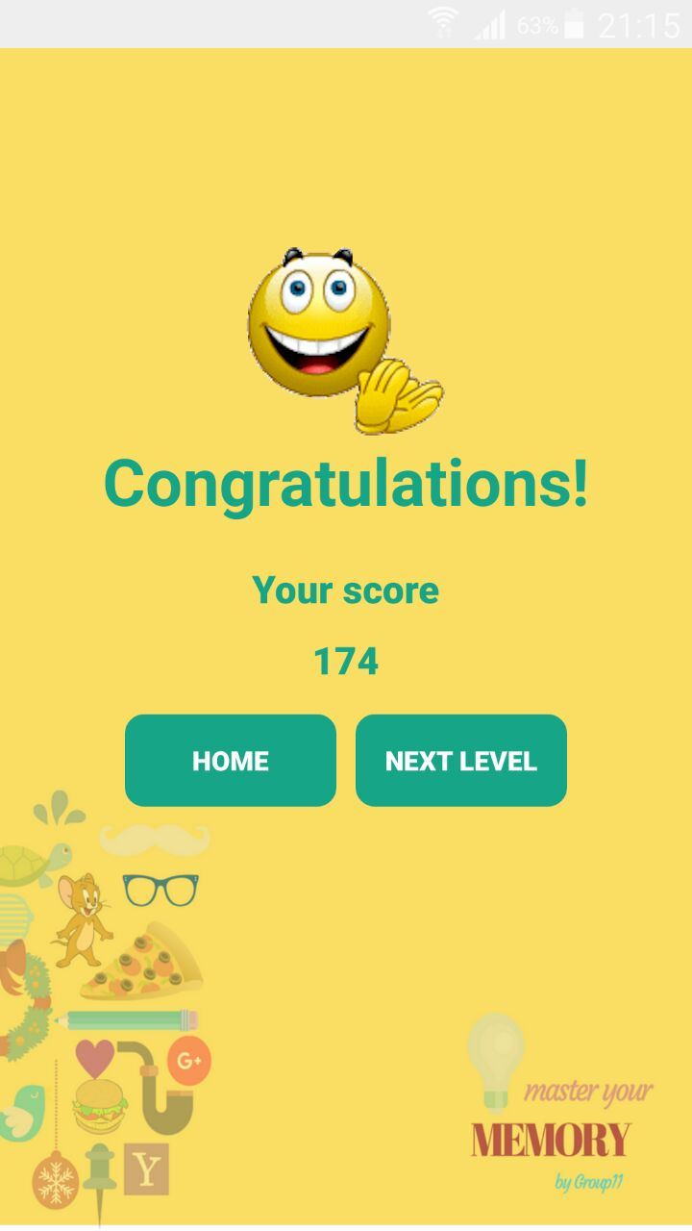
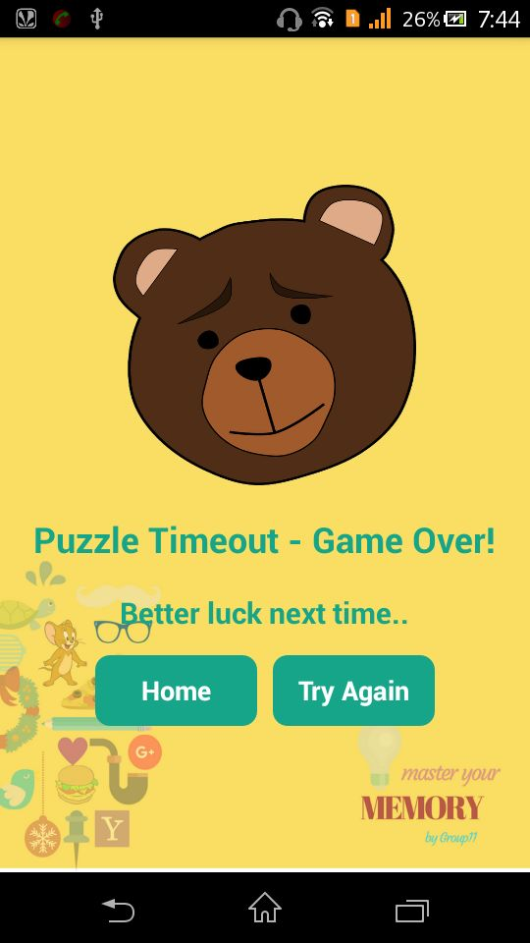
Congratulation & Game Over Screen

Slide 8
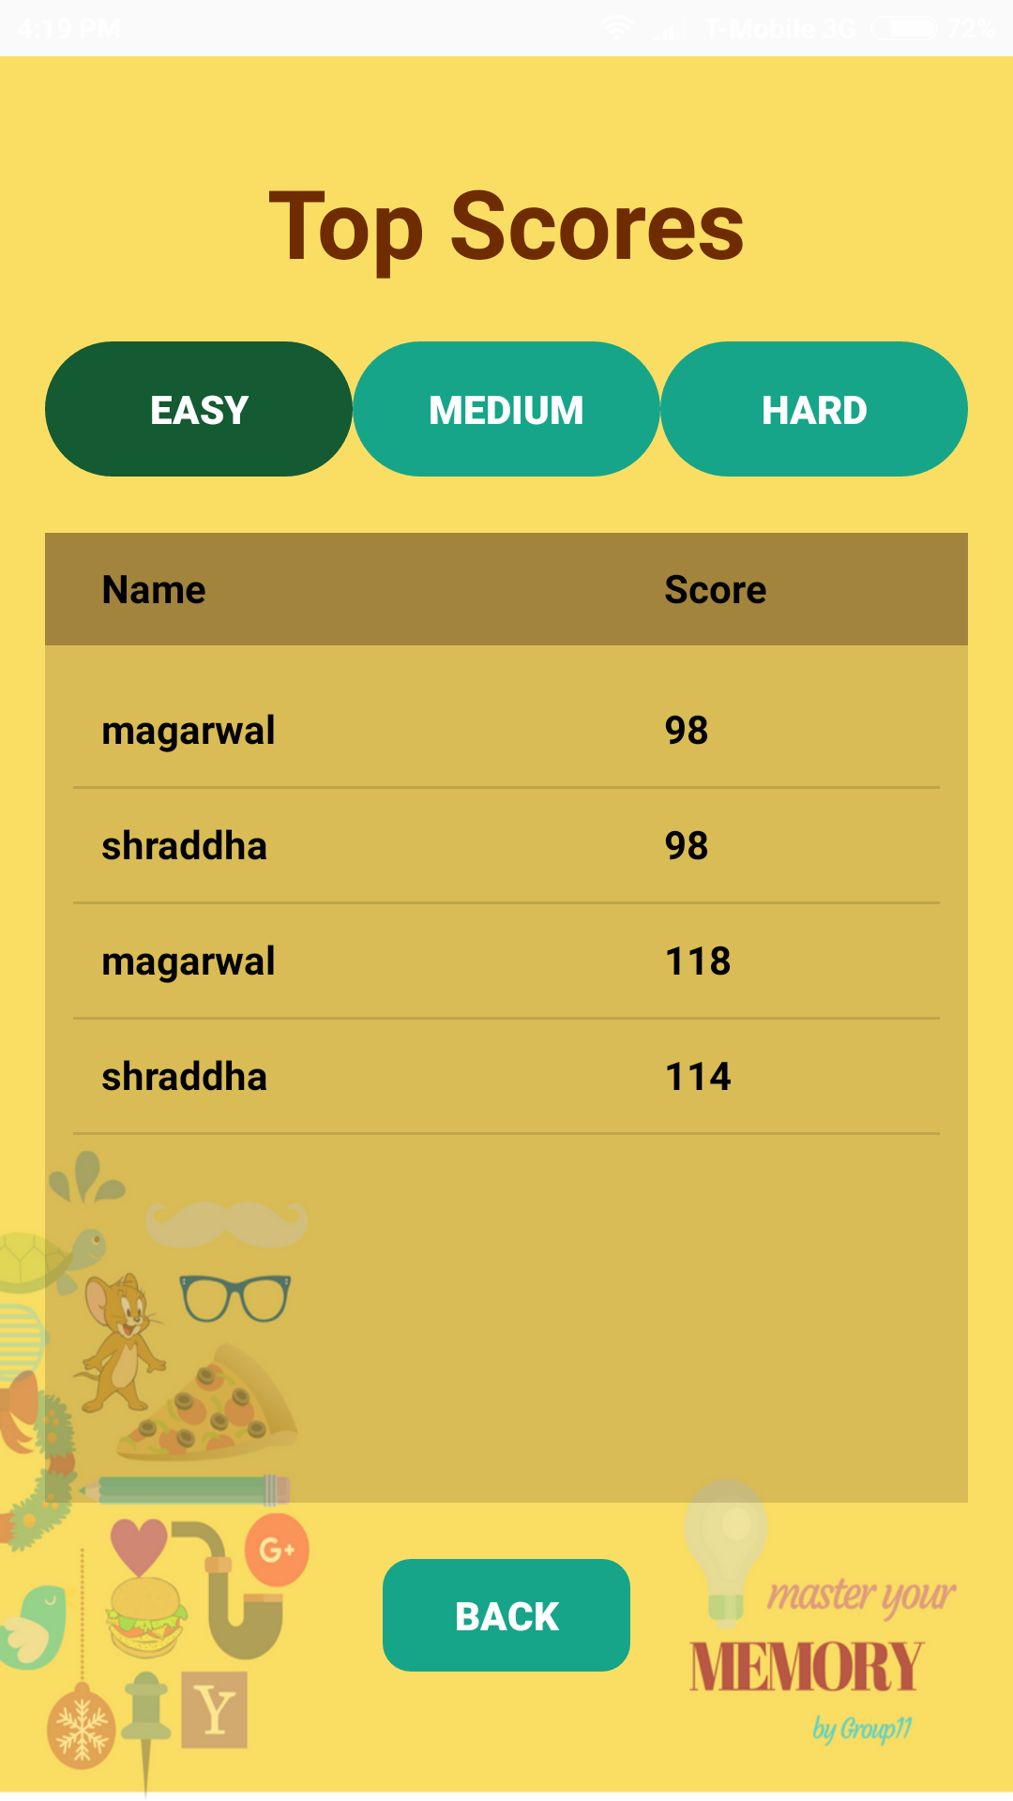
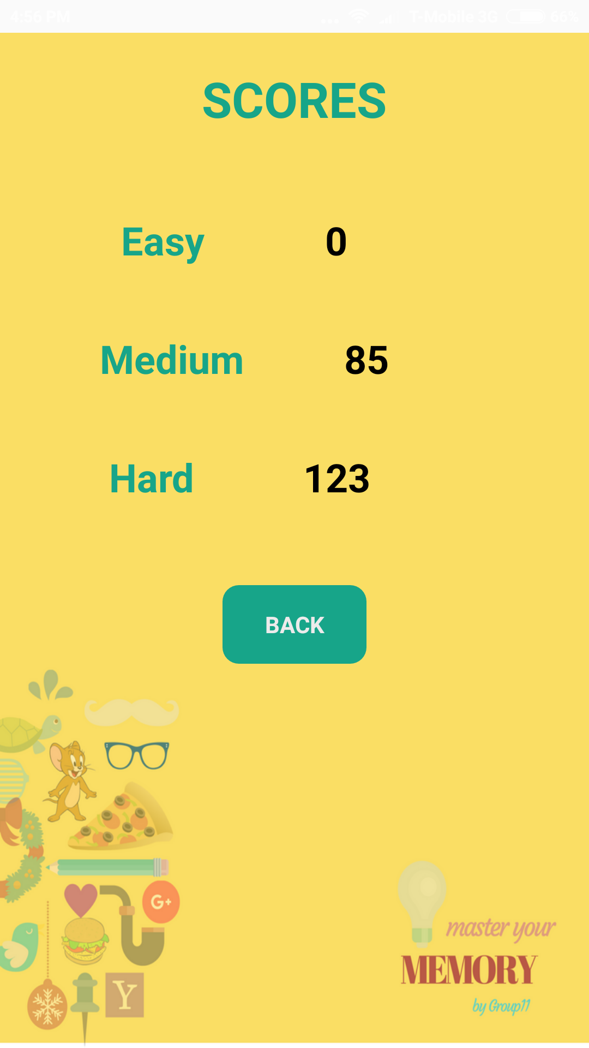
Top & Personal Score

Slide 9
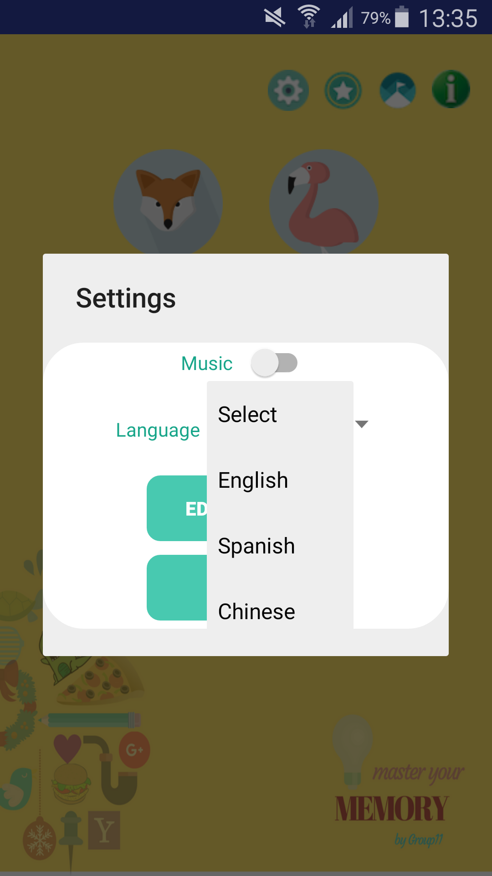
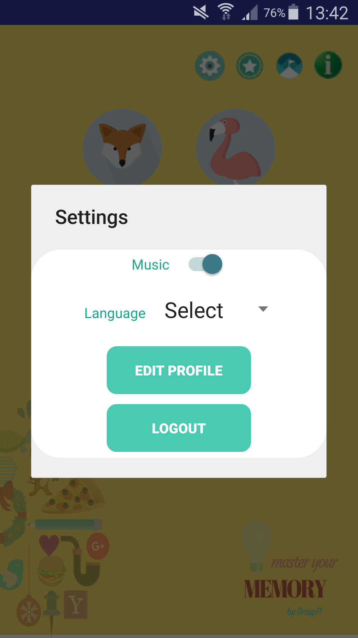
Personal Settings

Slide 10
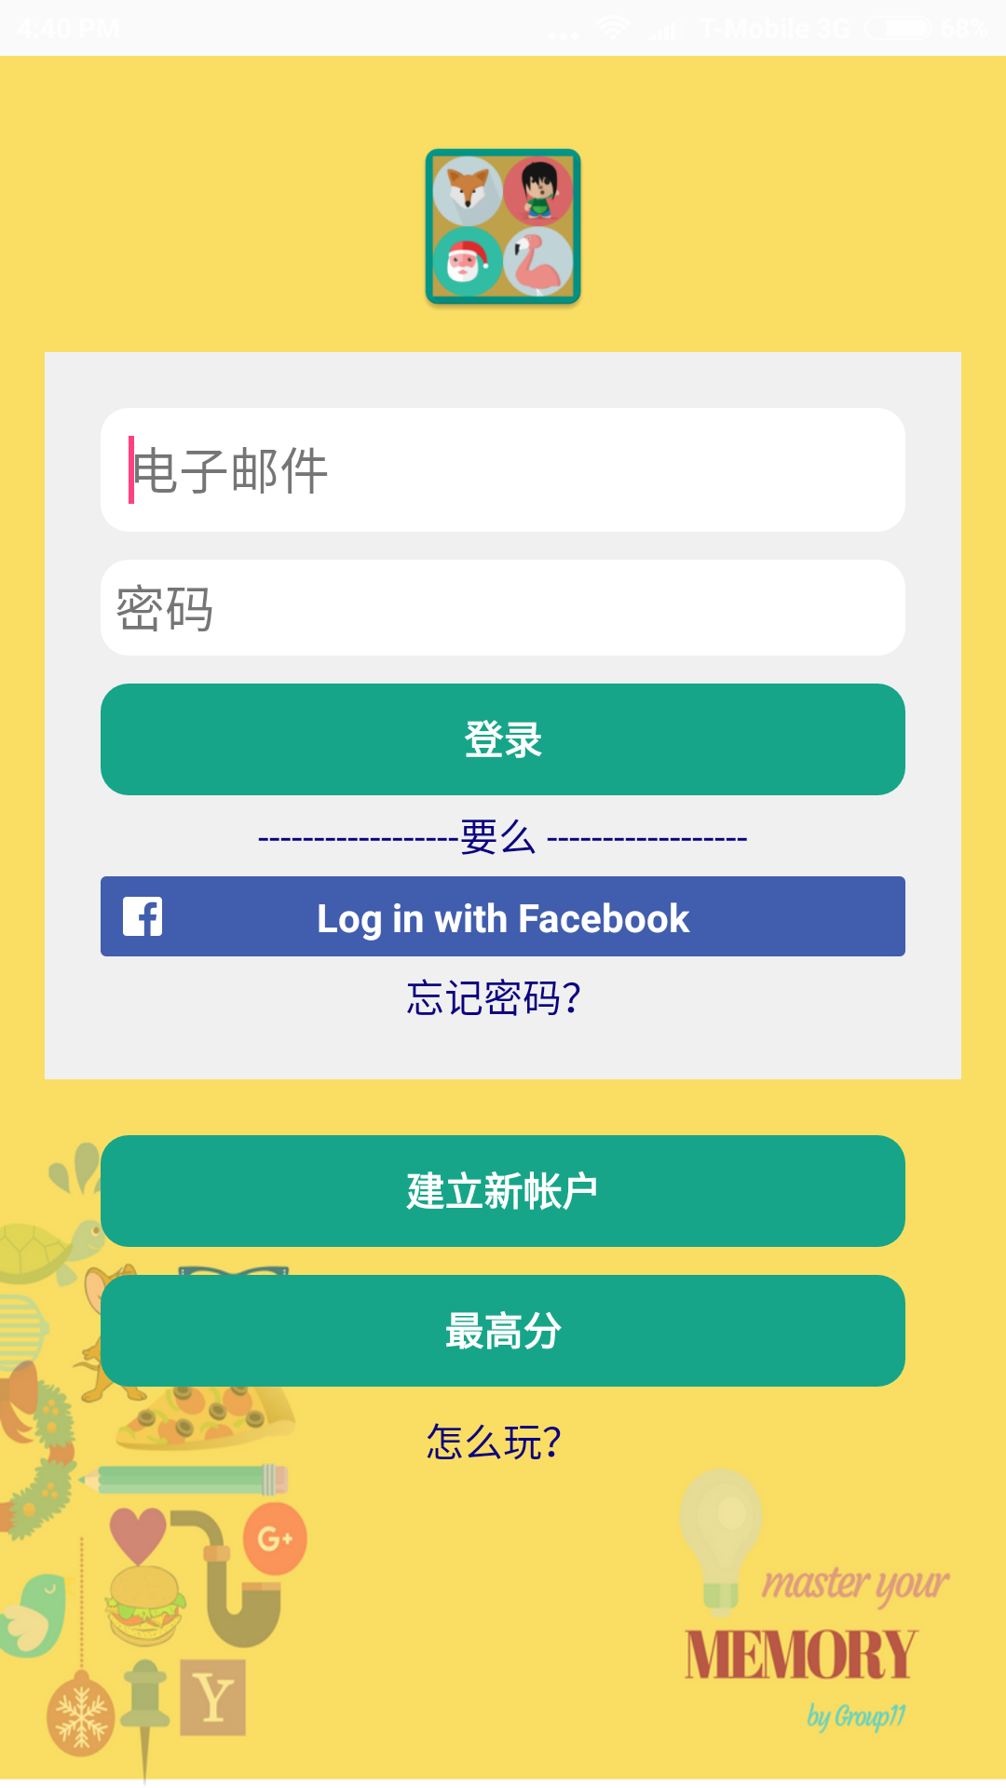
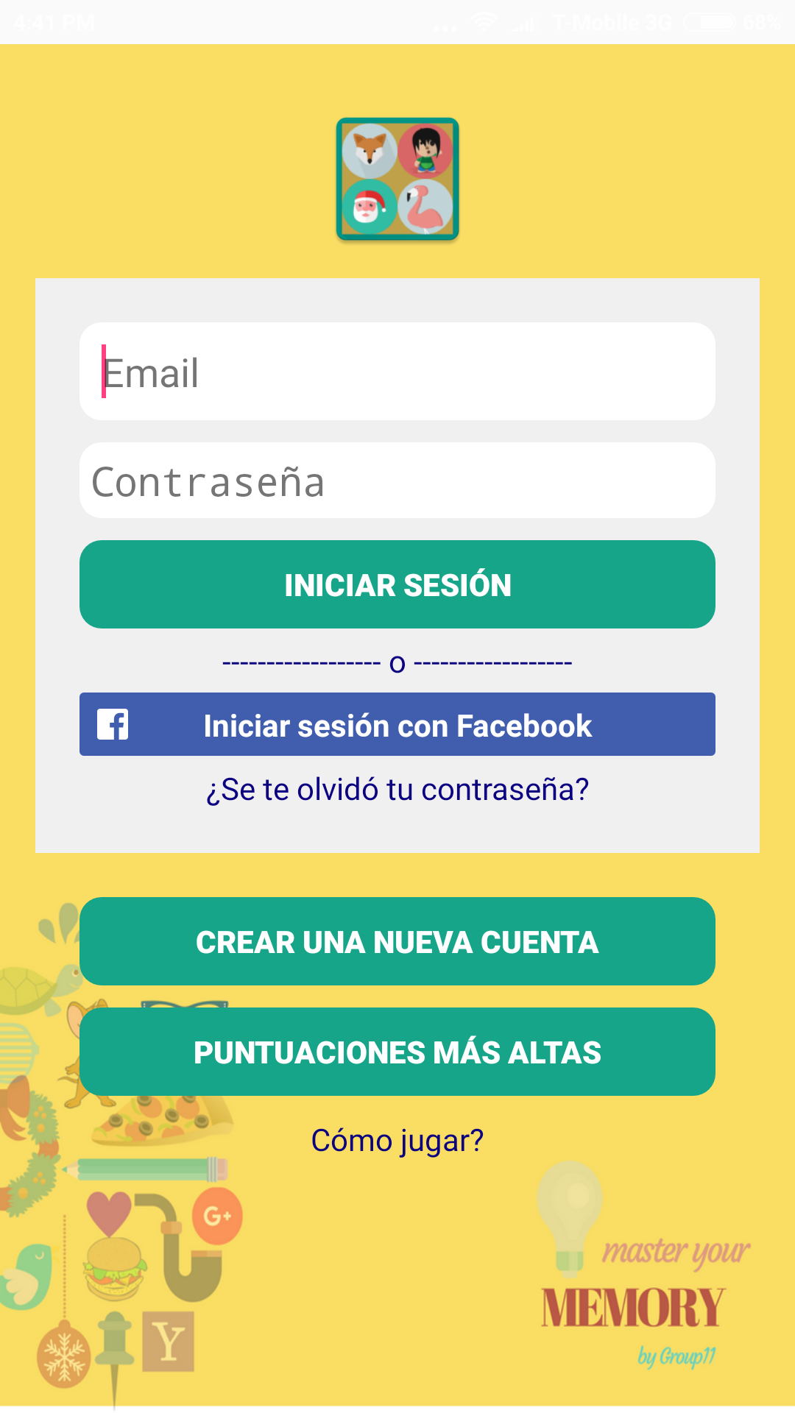
Multiple Languages

Slide 11

Why Our Application ???
It’s free
User Profile
Categories with difficulties and Levels
Multiple Languages
Attractive User Interface

Slide 12

Problem Encountered
P: Too many Images
S:Increased Heap Size
P:Facebook and Splash Activity together
S: No Solution as Only One Will Work
P: Database Handling with multiple languages
S: Change Database implementation

Slide 13
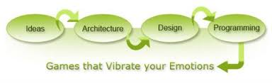
The Process
Phase 1: UI and activity transition
Phase 2: Registration, User Session, Game logic, Database implementation, Background Sound,Video integration for help
Phase 3: Forgot password, Facebook Login, Multiple languages, Database improvement, Animation at game completion, Game levels, Testing and bug fixing
Phase 4: Final Testing, Demo

Slide 14
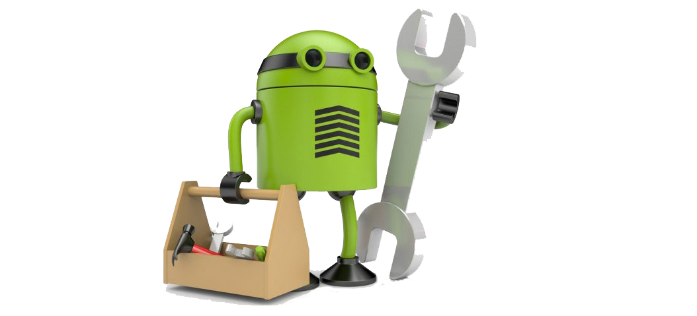
Android Design Pattern
Activity
Fragments
Services
Multimedia
Animation
Storage: SQLite
APIs Integration
Splash Screen

Slide 15

Future Enhancements
Online Database
Facebook Sharing

Slide 16
Contribution
 | Akash Pipalia | Bharatiben Kyada | Rohan Borde | Sudipta Swarnakar
Game Logic
UI
Loading Page
Registration
Login
Facebook Login
Edit Profile
Forgot Password
Scores
Help
Settings Dialog
Sound Settings
Multiple Language Settings
Game Levels
Database Handling
Game Finish Page

Slide 17
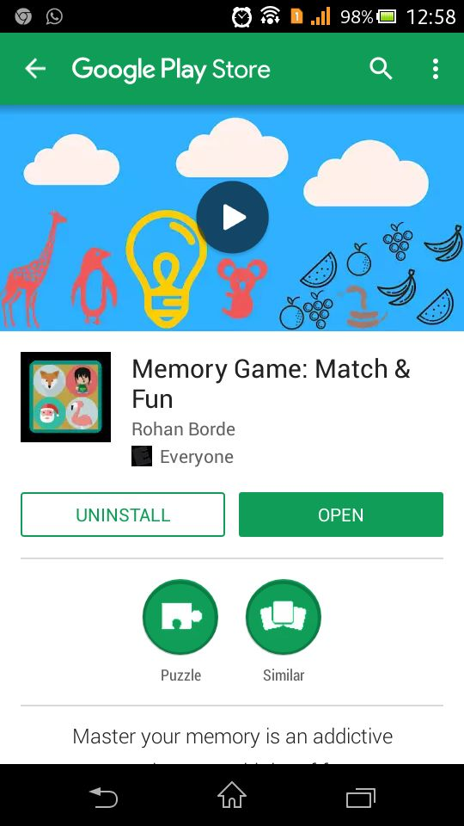
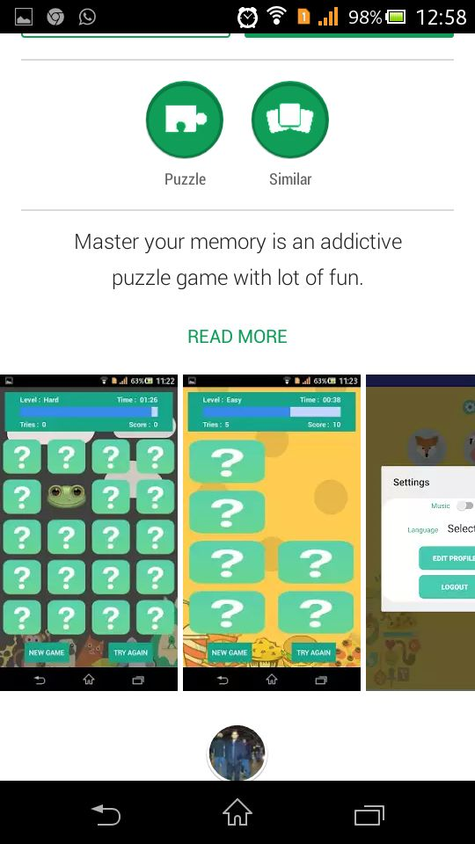
Find MYM on Google Play Store

Slide 18


